Slide 1
Swin Transformer: Hierarchical Vision Transformer using Shifted Windows
Simei Yan & Zitai Wu & Bangguo Xu & Liang Liu

Slide 2
Motivation
Challenges in adapting Transformer from language to vison
Large variations in the scale of visual entities:
Unlike the word tokens as basic elements, visual elements can vary substantially in scale.
In existing Transformer-based models, tokens are of a fixed scale, a property unsuitable for vision applications.
High resolution of pixels in images:
Some vision tasks require dense prediction at the pixel level, and this would be hard for Transformer, as the computational complexity is quadratic.

Slide 3
Motivation
Contribution
Construct hierarchical feature maps:
start from small-sized patches and gradually merge neighboring patches in deeper layers
Linear computional complexity with respect to image size:
computing self-attention locally within non-overlapping windows
Suitable as a general-purpose backbone for various vision tasks

Slide 4
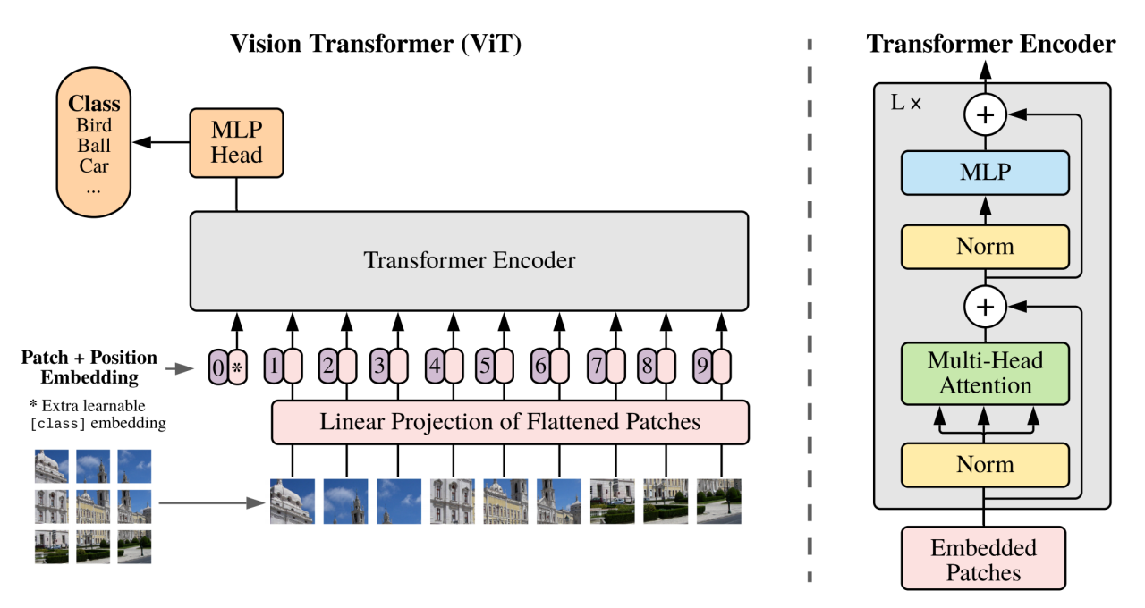
Related Work
Vision Transformer (ViT)
perform well on image classification tasks
Compute Self-attention globally
Low-resolution feature maps
Quadratic computation complexity

Slide 5
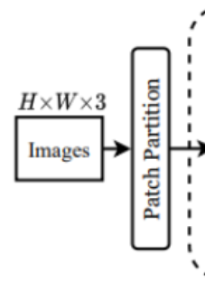
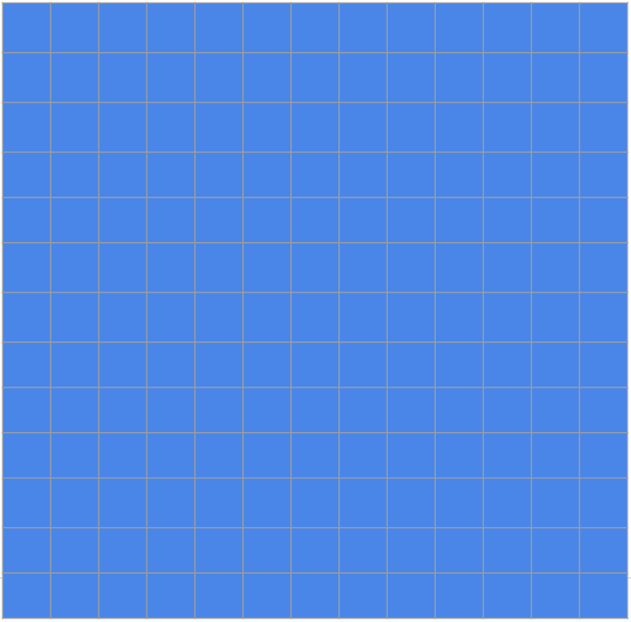
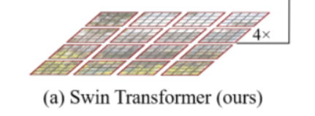
Swin Transformer architecture
Input
16x16x3(RGB)
Patch Patition
4x4 patches (each patch is 4x4 pixels)

Slide 6
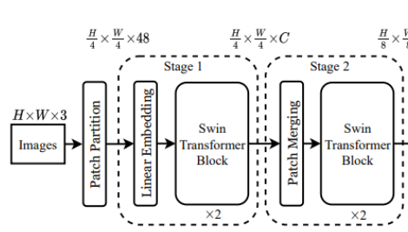
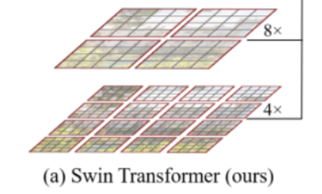
Swin Transformer architecture
Patch Merging
4 patches to 1 patch(using pooling or striding convolution)

Slide 7
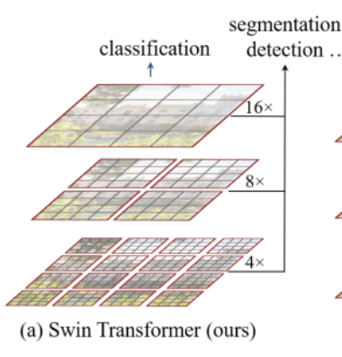
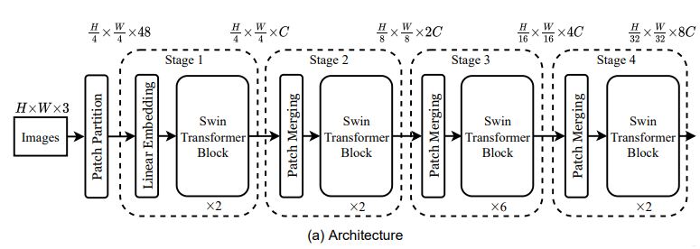
Swin Transformer architecture

Slide 8
Advantage(Reducing Computation)
(1)ViT
64×63=4032
Computational complexity：O(N^2)
8x8

Slide 9
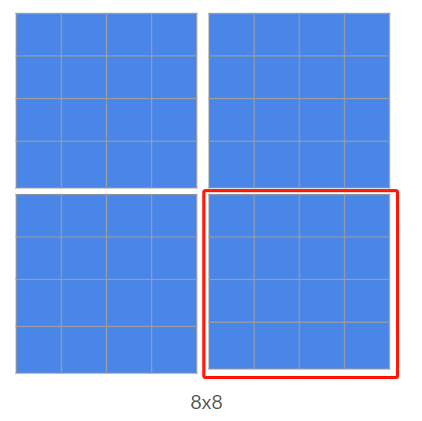
Advantage(Reducing Computation)
(1)ViT
64×63=4032
Computational complexity：O(N^2)
(2) Swin Transformer
16×15=240
Computational complexity：O(N)

Slide 10
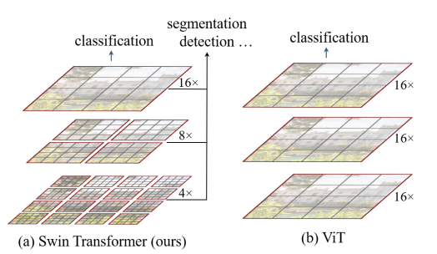
Advantage(Get features from different resolution)
This hierarchy allows the model to capture image features at different resolution, suitable for a variety of visual tasks from fine to rough.

Slide 11
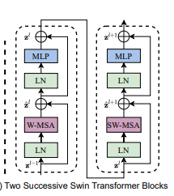
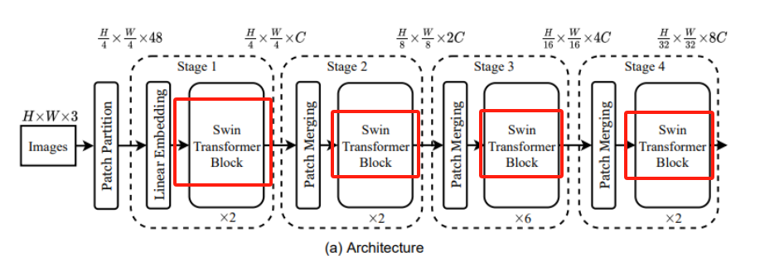
Swin Transformer Blocks

Slide 12
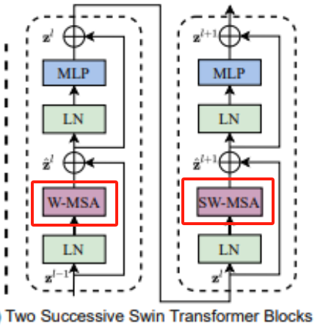
Swin Transformer Blocks
Function: Transform and refine image features.
W-MSA: Window Multi-head Self-Attention(lack of learning the relationship between the patches)
SW-MSA: Shifted Window Multi-head Self-Attention

Slide 13
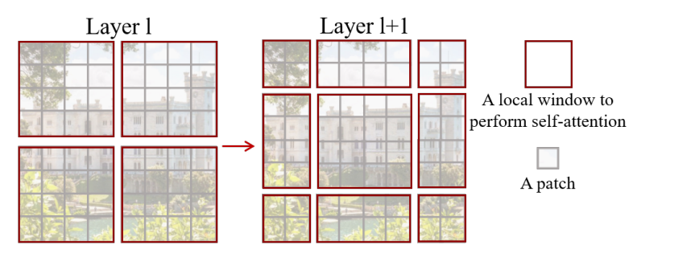
Shifted Window
If only use local self-attention inside each window, we cannot exchange information between windows even the patches are close to each other. So we need to shift the windows.
Shift the window to the bottom right.
The advantage of this is that the windows can interact with each other, because in the original way, there is no shift, and the windows do not overlap each other. If each self-attention operation is performed in a small window, the patch in each window will never be able to notice the information of the patches in the other windows.
Moving windows break the barriers between windows, allowing patches in different windows to "communicate" with each other.

Slide 14
Shifted Window
But how to deal with those incomplete segments?
The number of windows increased, and the size of the elements in each window is not the same.
Because the size of the window is not the same, we can’t pressed all the windows into a batch to directly calculate the self-attention.
One of the simple solution is to pad these small windows by 0, pad them with the same size as the middle window , so there are 9 exactly the same size windows, so that they can still be pressed into a batch.
However, this inadvertently increases the computational complexity because originally, if calculating self-attention based on windows, only 4 windows need to be calculated, but now 9 windows need to be computed, which more than doubles the complexity.

Slide 15
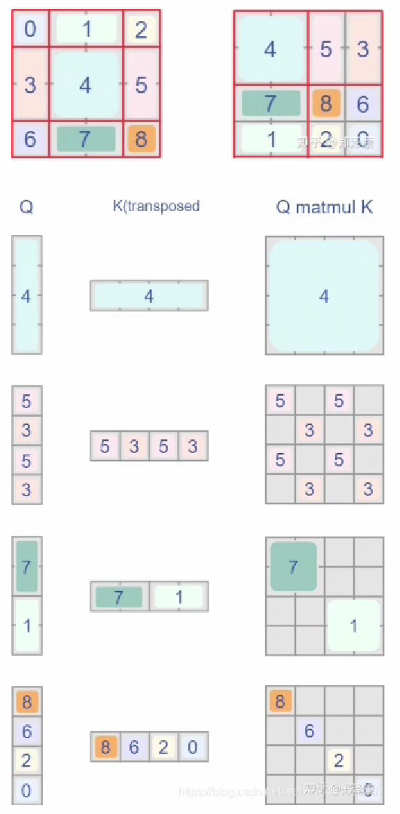
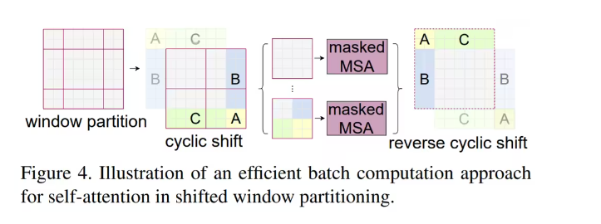
Cycle shift and Mask
Efficient batch computationa for shifted configuration

Slide 16
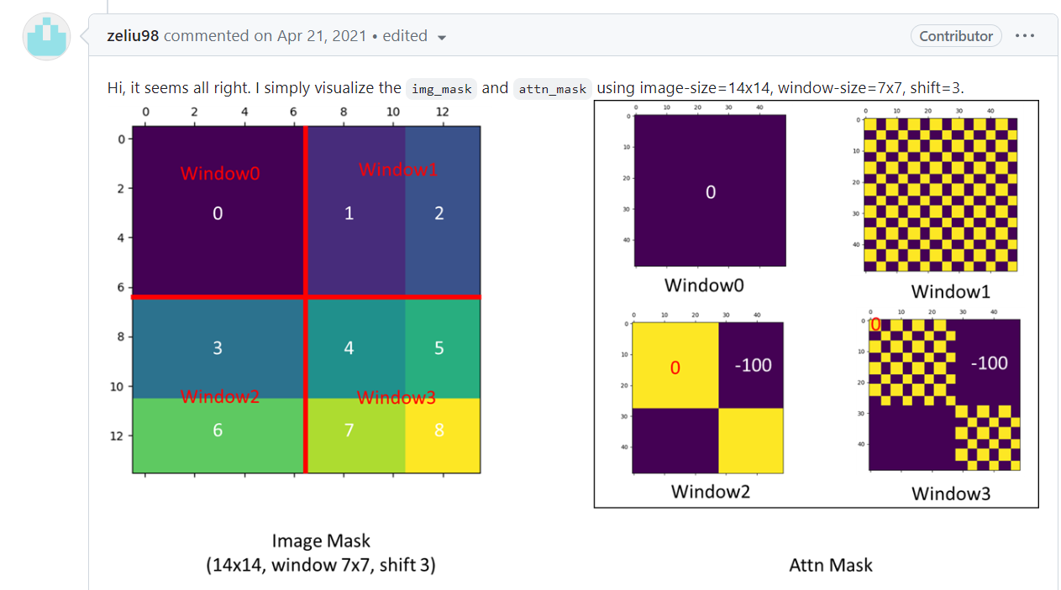
Cycle shift and Mask
Efficient batch computationa for shifted configuration

Slide 17
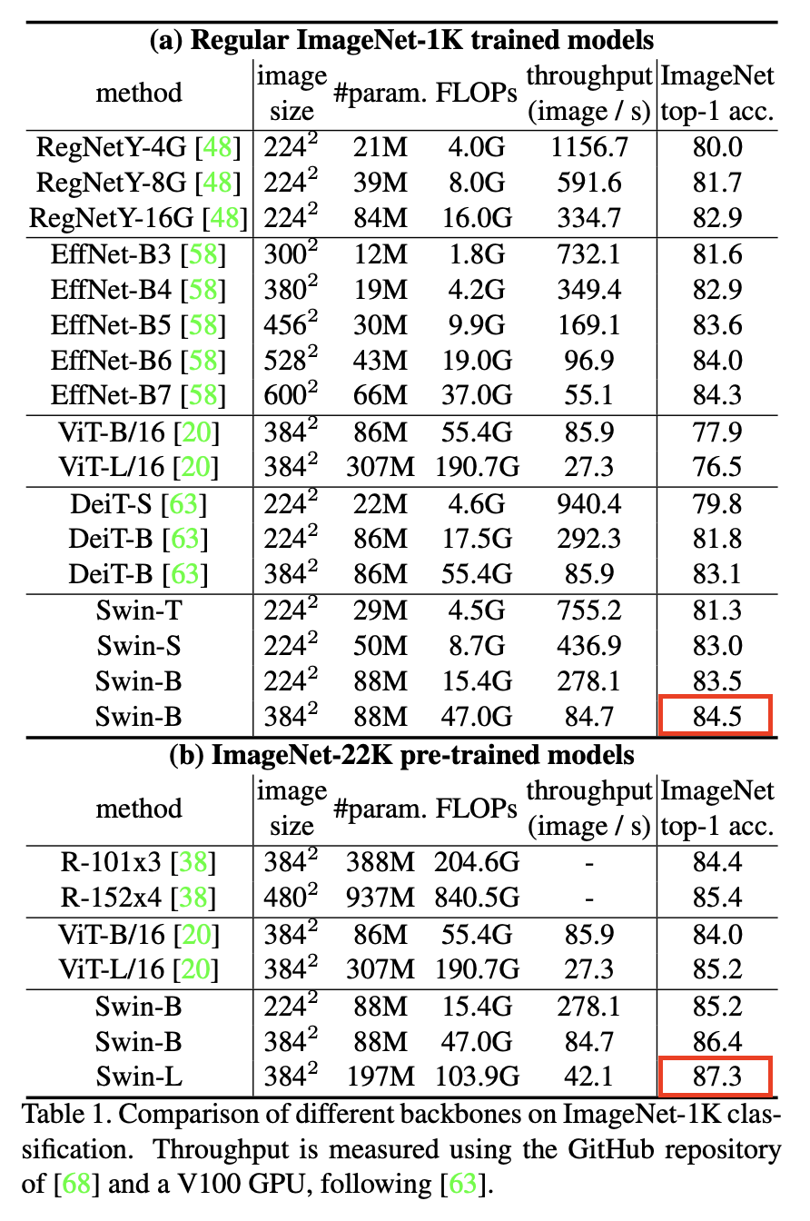
Experiments
ImageNet 1K image classification
Two Pre-training Methods:
Standard ImageNet-1K with 1.28 million images, 1,000 classes.
Larger ImageNet-22K with 14 million images, over 20,000 classes.
Final Testing Uniformity:
All models are tested on the ImageNet-1K test set for consistency.
Top Model Performances:
RegNet and EfficientNet were top-performing models, reaching up to 84.3% accuracy.
Swin Transformer models outperformed previous models, with Swin Base reaching 84.5% accuracy.
Improvements with ImageNet-22K:
Pre-training on ImageNet-22K significantly boosts ViT models' performance.
Swin Large achieves top accuracy of 87.3%

Slide 18
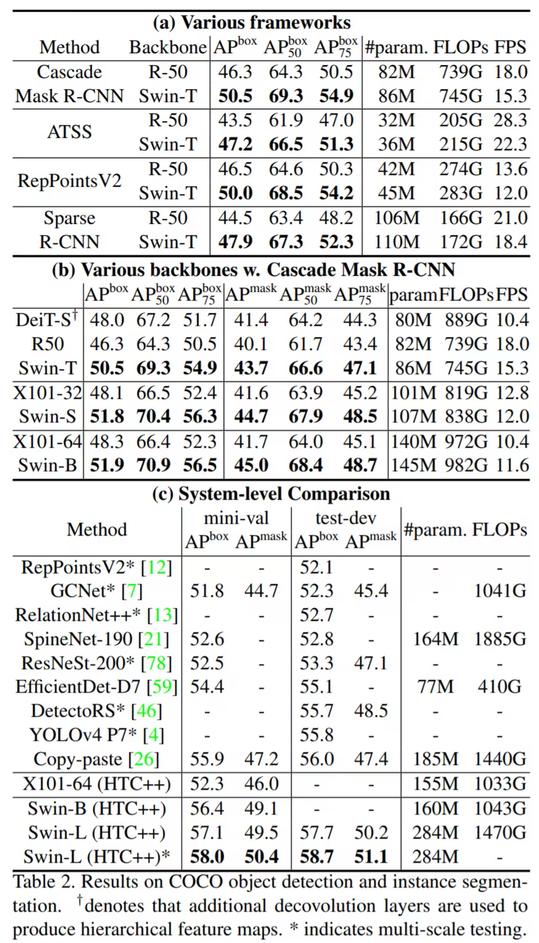
Experiments
coco object detection
Swin Transformer as a Backbone:
Swin Transformer outshines the ResNet-50 backbone in various algorithms including Mask R-CNN and ATSS
Comparative Analysis:
Swin Tiny demonstrates significant improvement over ResNet-50, with fair comparison due to similar parameter and FLOP counts.
Enhanced Detection Performance:
When integrated into Cascade Mask R-CNN, Swin Transformer backbones surpass other networks with comparable parameters and computational efficiency.
System-Level Advancements:
Swin Large achieves new state-of-the-art results on COCO, exceeding past methods by 2-3 points even with advanced techniques like test time augmentation (TTA).

Slide 19
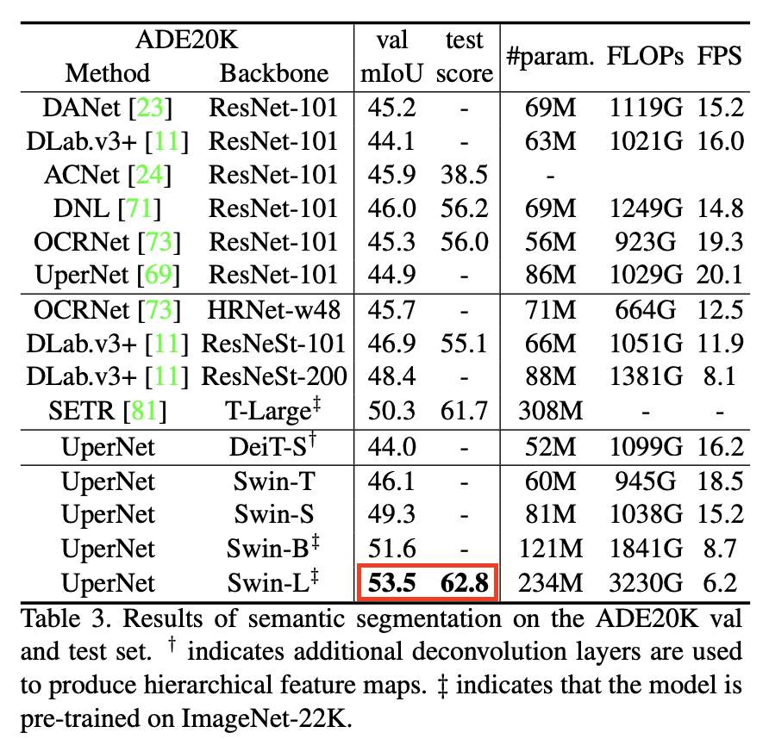
Experiments
Semantic Segmentation on ADE20K
The experiment assesses semantic segmentation using the ADE20K dataset.
Previous CNN Approaches
Methods up to DeepLab V3 using ResNet backbones hovered around the 44-45 mIoU range.
Vision Transformer Impact
The introduction of Vision Transformers, like SETR with T- Large, pushes performance to a 50.3 mIoU.
Swin Transformer Advancement
Swin Transformer Large further elevates the benchmark to a 53.5 mIoU.
Pre-training Influence
Models marked with "++" were pre-trained on ImageNet-22K, contributing to their superior performance.

Slide 20
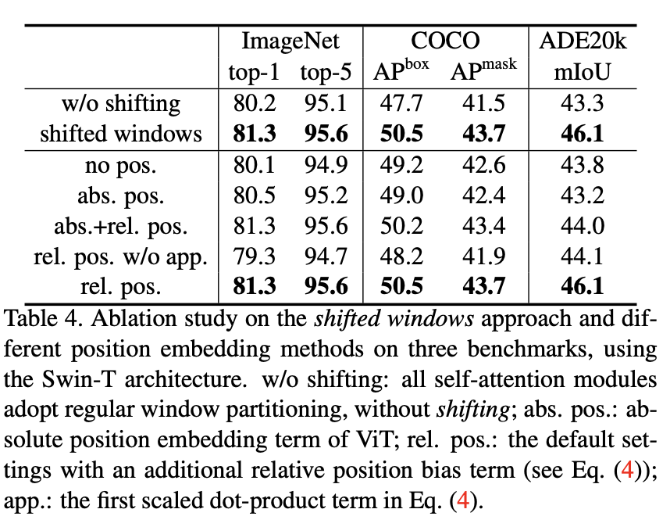
Experiments
Shifted Windows Efficacy: Research validates the shifted windows and relative position encoding in Swin Transformer for enhanced performance.
ImageNet Gains: Modest but significant gains in ImageNet classification, with a 1-point increase noted.
Downstream Task Benefits: Marked improvements in COCO object detection and ADE20K semantic segmentation from these features.
Detection and Segmentation Boost: Shifted windows and relative position encoding bring a 3-point performance uplift in both COCO and ADE20K tasks.

Slide 21
Conclusion
Swin Transformer is a hierarchical Transformer, which can serve as a backbone to downstream dense prediction tasks.
Linear computational complexity with respect to the input image size.
Using local self-attention inside each window.
Using shifted windows to exchange information between windows.

Slide 22
Thank you！
、

